Slide 1
DETECTION OF CYBERBULLYING ON SOCIAL MEDIA PLATFORM
TEAM MEMBERS
JAYANTHI T - 1817119
KIRUTHIKA S - 1817125
VARUNA PRIYA S - 1817153
YAZHINI P - 1817157
PROJECT GUIDE
Dr.R.BHAVANI
AP-CSE

Slide 2
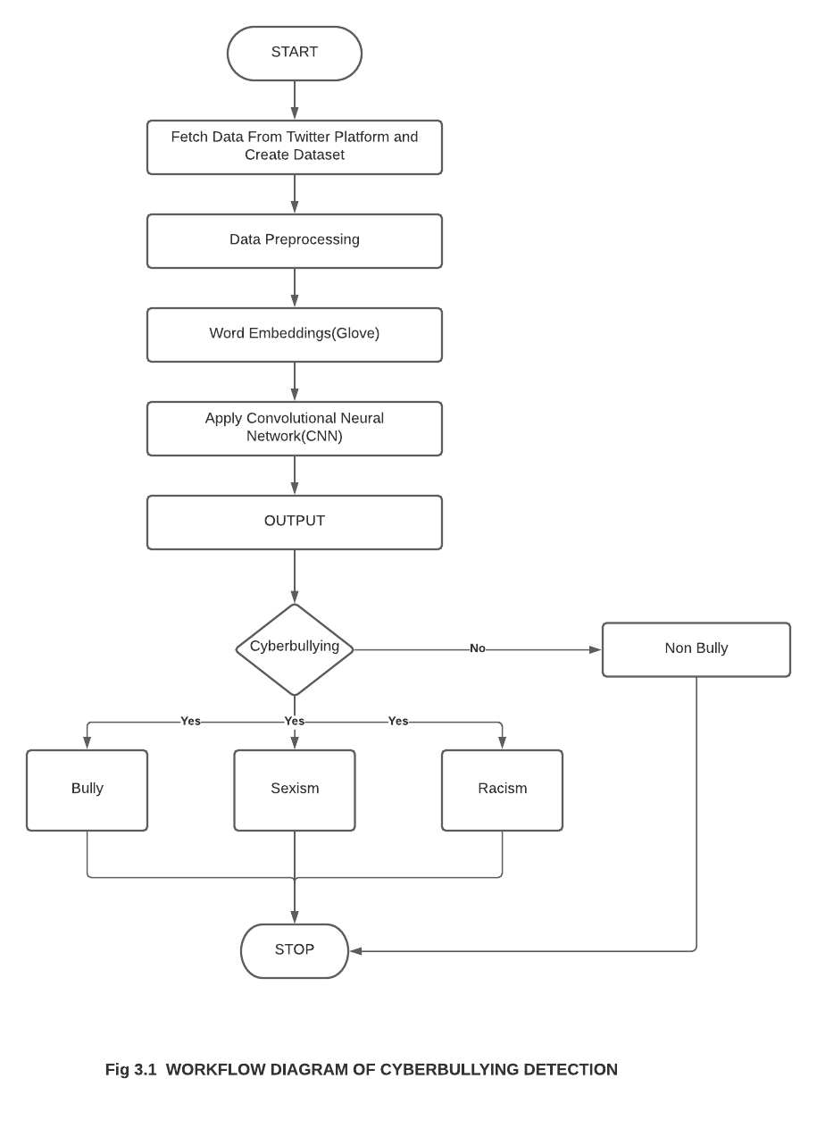
PROJECT WORKFLOW

Slide 3
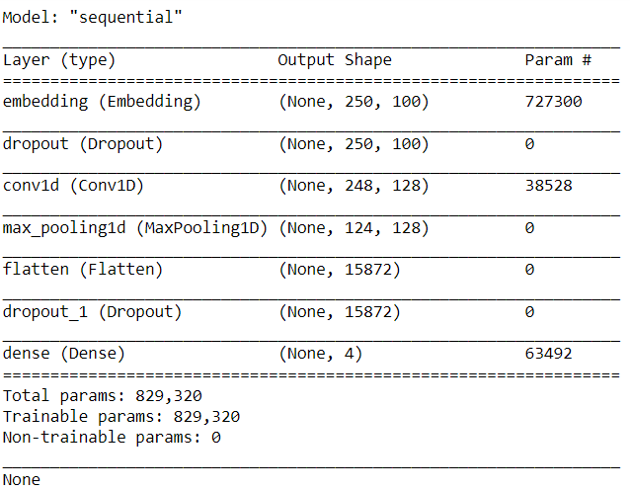
IMPLEMENTATION
MODEL SUMMARY

Slide 4
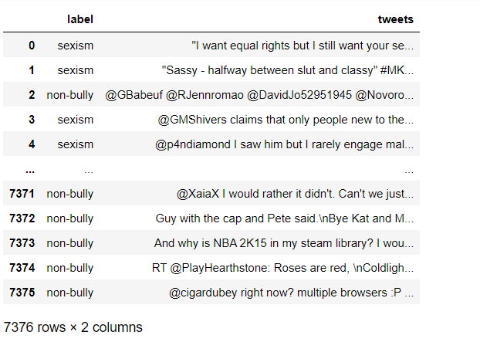
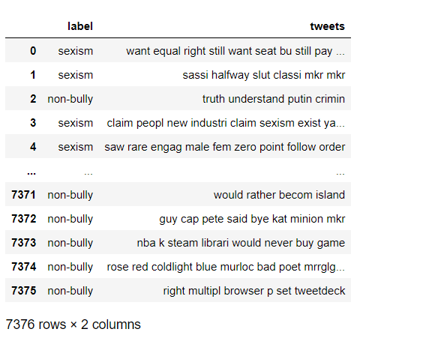
DATASET BEFORE AND AFTER PREPROCESSING

Slide 5
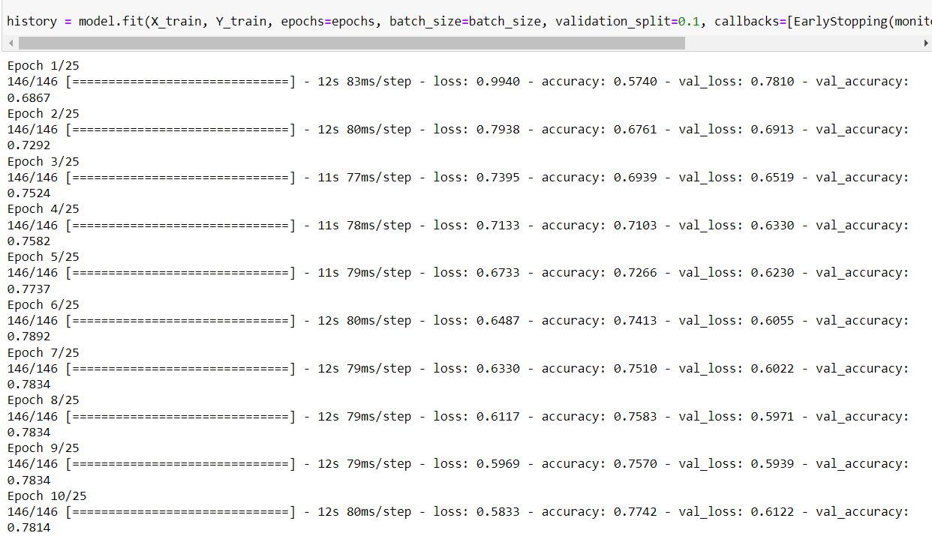
TRAINING THE DATASET

Slide 6
TESTING THE DATASET

Slide 7

SAMPLE OUTPUT

Slide 8
THANK YOU

